Slide 1

I need to build a complicated EA or indicator “SIGNAL ALERT” for STOCKS OPTIONS TRADING (not forex, not binary, not MT4). I use ThinkorSwim, but we would need some MARKET DATA API service. Searching on the web I found this explanatory video on how to scan for Unusual Volume using Market Chameleon. https://youtu.be/PCWD89bq7Cw
Then I learned on SWEEP OPTIONS and the tell, “Aggressiveness” when the buyer is willing to pay near or at the ask price. I found that Bezinga Pro has a great tool for this. https://youtu.be/-WfrYa7ESQo
After watching this Unusual Options Scanner, I need something similar to this: https://neuromastersoftware.com/optionscanner_special/special_offer.html but it seems it provides last trading day activities, not live.
We would need to optimize or automate my Options trade preference, So I would like an ALERT SIGNAL with the following criteria:
• Order Type
• Expiration
• Bid, near Ask, or Ask Price
• IN % Rank
• IV30
• Volume Level
• Volume vs. Open Interest
• Relative Opt. Volume
• 1 Day Volatility
Check this API services:
https://www.xignite.com/product/global-real-time-option-price-data#/productoverview
https://datashop.cboe.com/web-api
https://product.intrinio.com/financial-data/opra-realtime-options-prices
http://www.iqfeed.net/index.cfm?displayaction=data&section=services
http://www.nanex.net/2019/
https://www.orats.com/options-data-products/
https://cloud.benzinga.com/
https://developer.tdameritrade.com/apis
LOOPAH
Options Signals

Slide 2
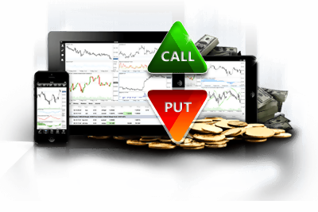

LOOPAH
Options Signals
The Most Powerful Tool in Option Trading.
With LOOPAH hybrid model you can track the sharks and know right away when big option plays are underway. LOOPAH combines human and Artificial Intelligence to collectively achieve superior results and learn from each other. Because the brain and AI use fundamentally different algorithms, each shine in tasks that the other utterly fails in.
Scan the entire order flow
Be the first to know
Setup custom option alerts that match your trading style
3 Pre-built trading models
Real time unusual volume data
Sweep, multileg block order tracking
SET YOUR OWN TRADING STRATEGY
Or trade with one of our pre-built setups
UNUSUAL TRADING VOLUME
SWEEP-MULTILEG
VOLUME Vs. OPEN INTEREST

Slide 3
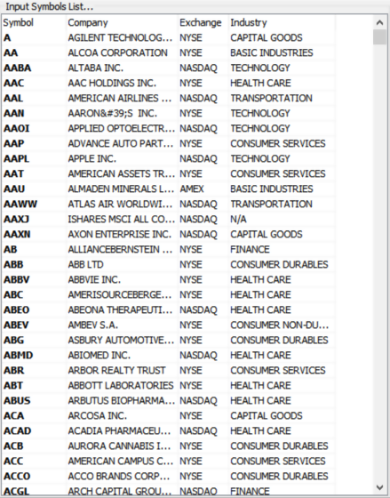

Scanning Criteria’s Set-up
Custom Set-up
Unusual Trading Volume Set-up
Sweep-Multileg SETUP
Volume Vs. Open Interest SETUP
EXPIRY
IV30
IV % RANK
1 DAY
VOLATILITY
RELATIVE
VOLUME
OPTION VALUE
RELATIVE OPT
VOLUME
SCAN

Slide 4
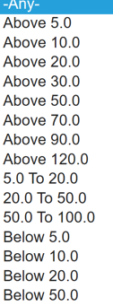
Scanning Criteria’s Set-up
Custom Set-up
Unusual Trading Volume Set-up
Sweep-Multileg SETUP
Volume Vs. Open Interest SETUP
EXPIRATION
IV30
IV % RANK
1 DAY
VOLATILITY
RELATIVE
VOLUME
OPTION VALUE
RELATIVE OPT
VOLUME
SCAN

Slide 5
Scanning Criteria’s Set-up
Custom Set-up
Unusual Trading Volume Set-up
Sweep-Multileg SETUP
Volume Vs. Open Interest SETUP
EXPIRY
IV30
IV % RANK
1 DAY
VOLATILITY
RELATIVE
VOLUME
OPTION VALUE
RELATIVE OPT
VOLUME
SCAN

